Slide 1
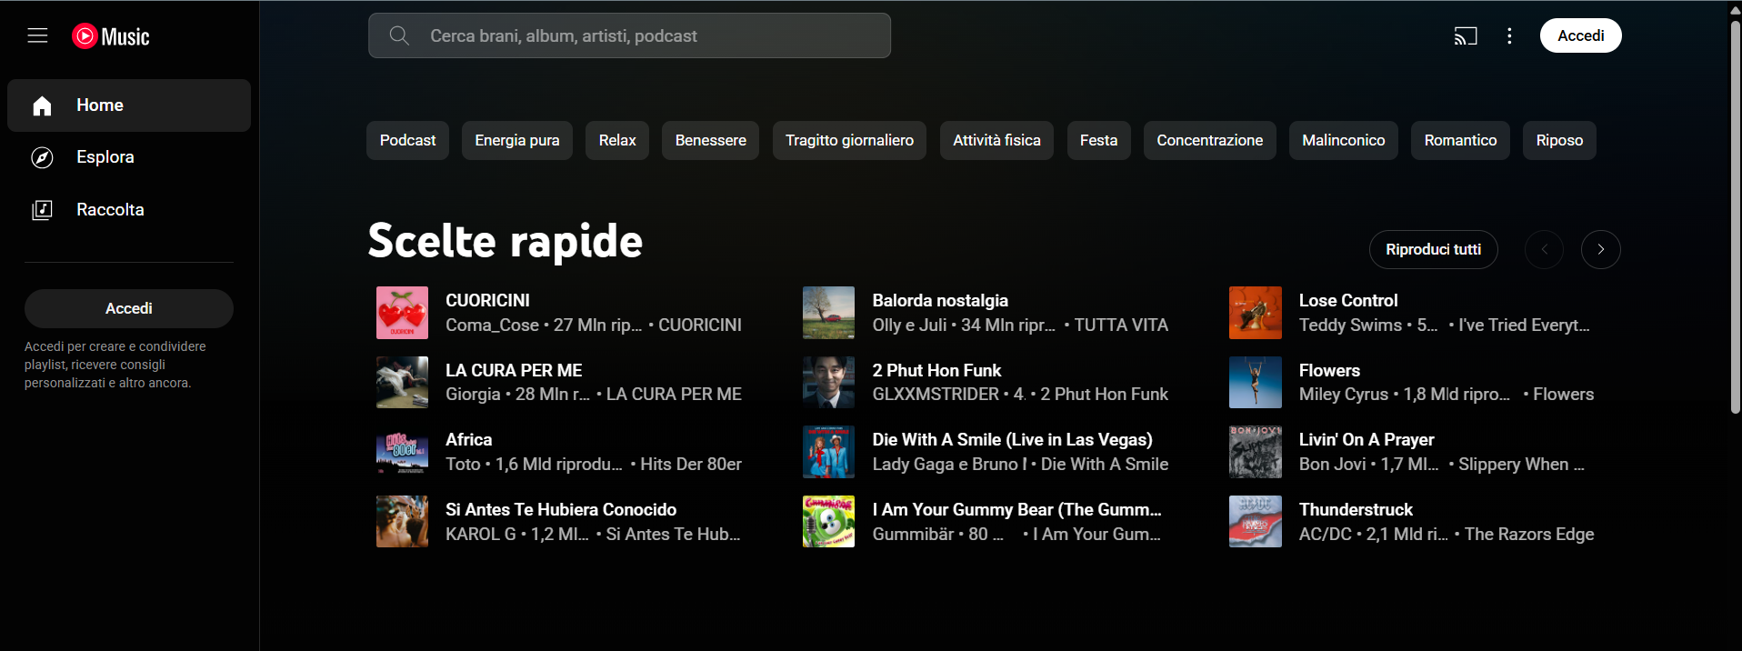
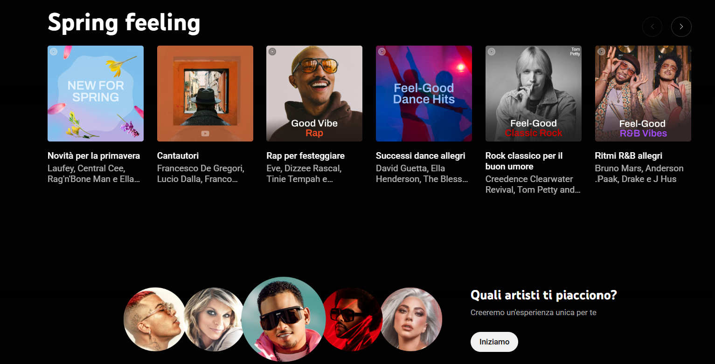
MiniHomework 1
Carmelo Salemi Scarcella 1000032013
https://music.youtube.com/

